Slide 1

ME23312 ENGINEERING THERMODYNAMICS
Unit III – Properties of Pure Substance · Presentation 2 of 10
Formation of Steam at Constant Pressure
Heating water at constant pressure · compressed liquid, saturated liquid, wet steam, dry saturated and superheated vapour · saturation temperature and pressure · the T–Q diagram · sensible and latent heat
Dr. Anantha Raman L., M.E., Ph.D. · Associate Professor, Department of Mechanical Engineering, Rajalakshmi Institute of Technology, Chennai

Slide 2

In this presentation
Heating water at constant pressure
The five states a to e
Saturation temperature and saturation pressure
Fixing the state of wet steam
The T–Q diagram
Sensible heat and latent heat
Latent heat depends on the pressure
ME23312 Engineering Thermodynamics · Unit III · Presentation 2
2

Slide 3
Heating water at constant pressure
1
ME23312 Engineering Thermodynamics · Unit III · Presentation 2
3

Slide 4
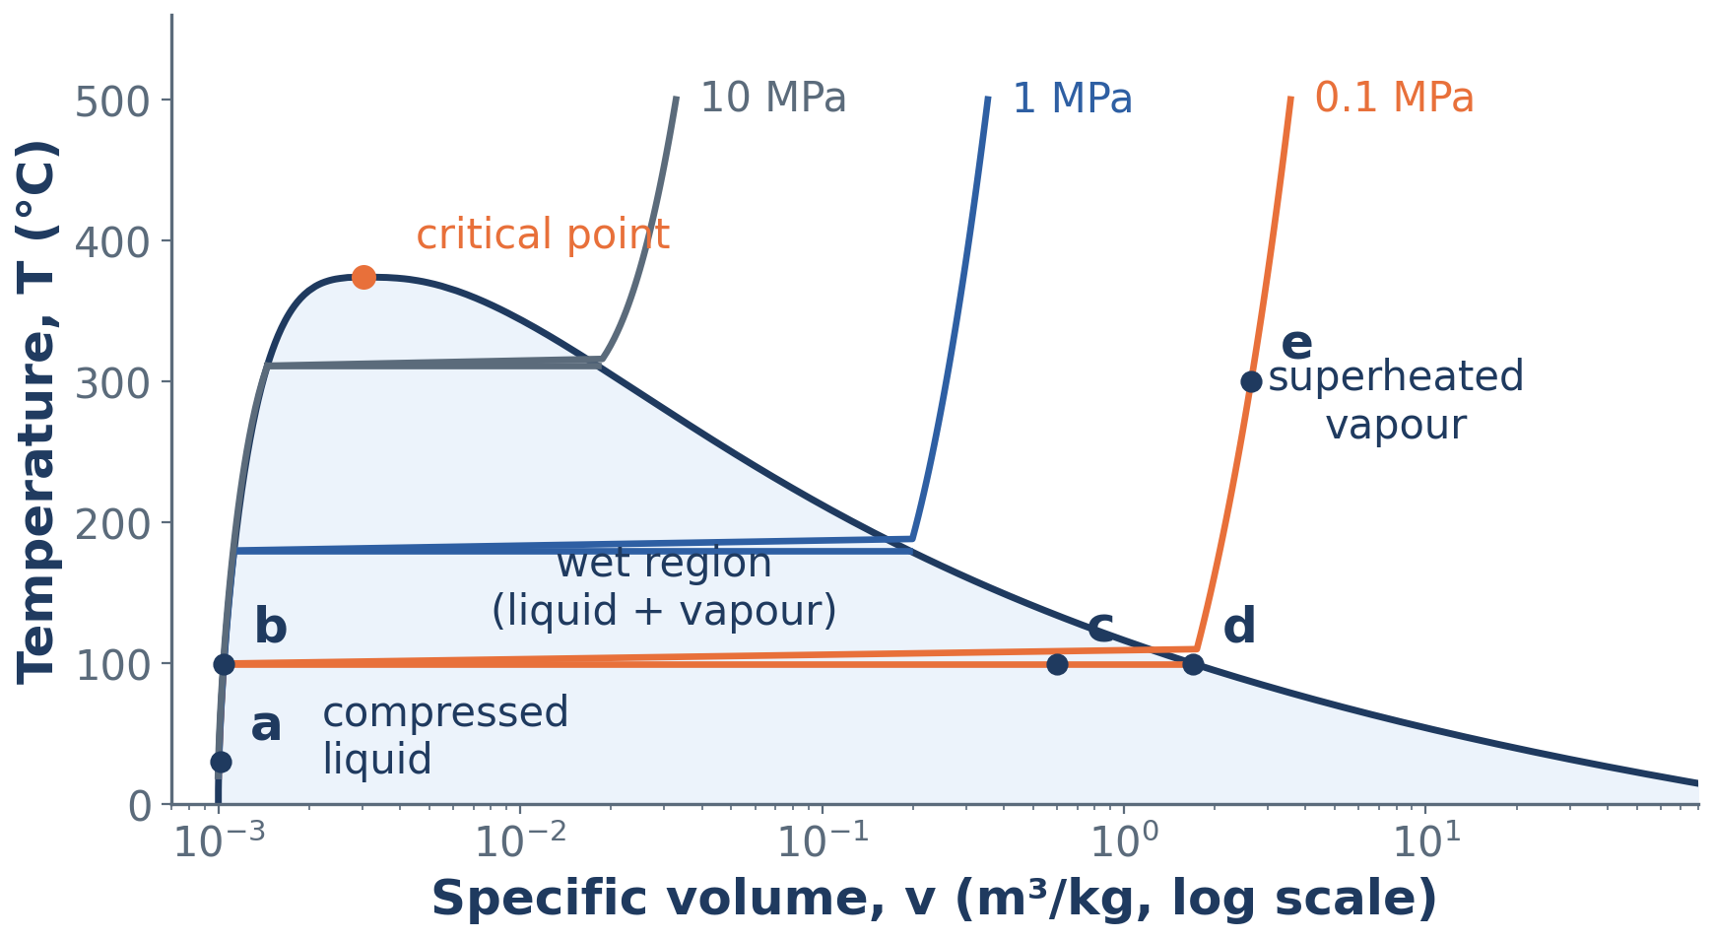
Formation of steam on the T–v diagram
1 kg of water heated at a constant 0.1 MPa: states a → b → c → d → e; isobars at 0.1, 1 and 10 MPa; the saturation dome
ME23312 Engineering Thermodynamics · Unit III · Presentation 2
4

Slide 5
States a and b
a Compressed (subcooled) liquid
b Saturated liquid
Water at 30 °C, below its boiling point for the pressure: p > p_{sat}(30 °C) = 4.25 kPa (compressed); T < T_{sat}(0.1 MPa) = 99.6 °C (subcooled). Heating raises T; the volume grows only slightly.
At 99.6 °C the water is about to boil – any further heat begins vaporisation. Properties carry the subscript f: v_{f}, u_{f}, h_{f}, s_{f}.
ME23312 Engineering Thermodynamics · Unit III · Presentation 2
5

Slide 6
States c and d
c Wet steam
d Dry saturated vapour
Liquid turns to vapour at constant T and p; the volume grows enormously (0.001043 → 1.694 m³/kg at 0.1 MPa). A two-phase mixture of saturated liquid and saturated vapour in equilibrium.
The last drop of liquid has vaporised: vapour at T_{sat} with no moisture (subscript g: v_{g}, u_{g}, h_{g}, s_{g}), on the point of condensing if heat is removed.
ME23312 Engineering Thermodynamics · Unit III · Presentation 2
6

Slide 7
State e – superheated vapour
Further heating raises the temperature above the saturation temperature; the temperature and the volume both increase with heat addition.
Superheated steam is fixed by two independent properties, normally p and T
ME23312 Engineering Thermodynamics · Unit III · Presentation 2
7

Slide 8
Saturation temperature and pressure
2
ME23312 Engineering Thermodynamics · Unit III · Presentation 2
8

Slide 9
Saturation temperature and saturation pressure
T_{sat} – the temperature at which a pure substance changes phase at a given pressure
p_{sat} – the pressure at which it changes phase at a given temperature
Uniquely related along the vapour-pressure curve: T_{sat} rises with pressure
Why a pressure cooker cooks faster, and why boiler pressures are raised to reach higher cycle temperatures
ME23312 Engineering Thermodynamics · Unit III · Presentation 2
9

Slide 10
Boiling point of water against pressure
Pressure | Saturation temperature
0.1 MPa | 99.6 °C
1 MPa | 179.9 °C
10 MPa | 311.0 °C
22.06 MPa (critical) | 374.1 °C
ME23312 Engineering Thermodynamics · Unit III · Presentation 2
10

Slide 11
Fixing the state of wet steam
During a phase change T and p are not independent – fixing one fixes the other. A single one of them does not fix the state of wet steam.
A second property is needed: v, h, s or the dryness fraction x
ME23312 Engineering Thermodynamics · Unit III · Presentation 2
11

Slide 12
The T–Q diagram
3
Sensible heat, latent heat and superheat
ME23312 Engineering Thermodynamics · Unit III · Presentation 2
12

Slide 13
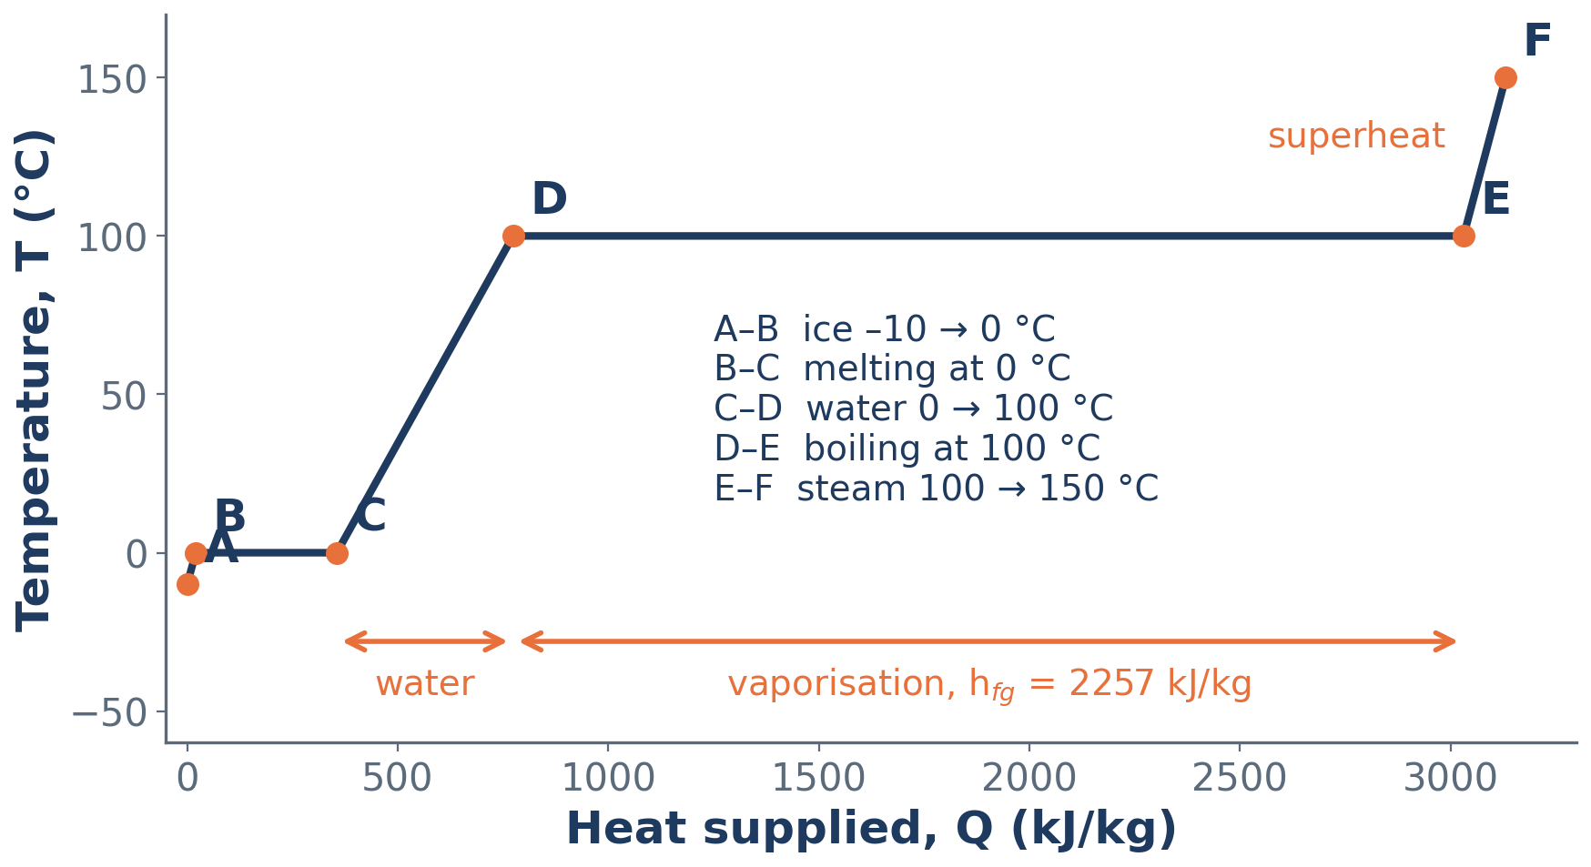
Ice at –10 °C to steam at 150 °C at 1 atm
Temperature of 1 kg of water plotted against the heat supplied
ME23312 Engineering Thermodynamics · Unit III · Presentation 2
13

Slide 14
Heat supplied: ice at –10 °C → steam at 150 °C
Segment | What happens | Heat (kJ/kg)
A–B | Sensible heat of ice, –10 → 0 °C: c_{ice} ΔT = 2.093 × 10 | 20.9
B–C | Latent heat of fusion – ice melts at 0 °C | h_{sf} = 334.5
C–D | Sensible heat of water, 0 → 100 °C: c_{w} ΔT = 4.187 × 100 | 418.7
D–E | Latent heat of vaporisation – water boils at 100 °C | h_{fg} = 2257
E–F | Superheat, 100 → 150 °C: c_{ps} ΔT ≈ 2.0 × 50 | ≈ 100
Total |  | ≈ 3131
ME23312 Engineering Thermodynamics · Unit III · Presentation 2
14

Slide 15
Sensible heat and latent heat
Sensible heat
Latent heat
Produces a change of temperature without a change of phase
Segments A–B, C–D and E–F
Absorbed or released at constant temperature during a change of phase
h_{sf} – latent heat of fusion
h_{fg} = h_{g} – h_{f} – latent heat of vaporisation at constant pressure
ME23312 Engineering Thermodynamics · Unit III · Presentation 2
15

Slide 16
Latent heat depends on the pressure
h_{fg} = 2257.5 kJ/kg at 0.1 MPa
h_{fg} = 2014.4 kJ/kg at 1 MPa
h_{fg} = 1317.6 kJ/kg at 10 MPa
h_{fg} = 0 at the critical point
KEY POINT Vaporisation is by far the largest item – more than five times the sensible heat of the water.
ME23312 Engineering Thermodynamics · Unit III · Presentation 2
16

Slide 17
Summary
Constant-pressure heating: compressed liquid → saturated liquid (f) → wet steam → dry saturated vapour (g) → superheated vapour
Volume grows enormously during vaporisation (0.001 → 1.7 m³/kg at 0.1 MPa)
T_{sat} and p_{sat} are uniquely related; T_{sat} rises with pressure
Wet steam needs a second property (v, h, s or x) to fix its state
Sensible heat changes temperature; latent heat changes phase at constant temperature
h_{fg} falls with pressure and vanishes at the critical point
ME23312 Engineering Thermodynamics · Unit III · Presentation 2
17

Slide 18
Next: Superheat, subcooling, critical and triple points
Degree of superheat and degree of subcooling
Evaporation versus boiling
The critical point and the triple point of water
ME23312 Engineering Thermodynamics · Unit III · Presentation 2
18

